Slide 1
Quiz - 10 minutes Start: 8:30am Pens down: 8:40am

Slide 2
Reminders & Upcoming Deadlines
Your project groups are due this Thursday (2/2/2023)

Slide 3
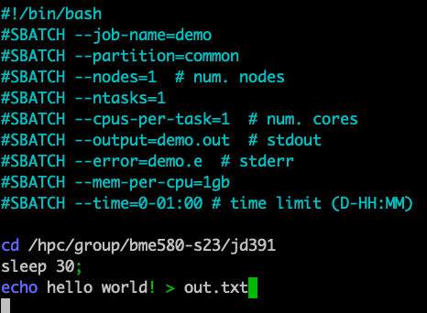
Note from last class: Syntax for submitting your program to the cluster scheduler
The # in front of SBATCH are necessary

Slide 4
Using Github Data Lineage: Electronic Health Records
Lecture 6

Slide 5
Github
Recall that we use version control and code sharing software to support reproducible data science!

Slide 6
What is GitHub?
GitHub is an open-source repository hosting service for code.
Variety of different programming languages
Keeps track of the various changes made to every iteration by using git, a revision control system that runs in the command line interface
Notes:
Source: https://www.thebalancecareers.com/what-is-github-and-why-should-i-use-it-2071946

Slide 7
Why should I be using GitHub?
> 28 million users- huge network!
Allows for easy collaborations
Trackable
Enables you to become active in the community
Improve your attractiveness as a job candidate (a public portfolio of your work as a data scientist!)
~1GB/repository (file <50-100MB)

Slide 8
Two Scenarios for Using Git
you want to track your own project
you want to start working on someone else’s project

Slide 9
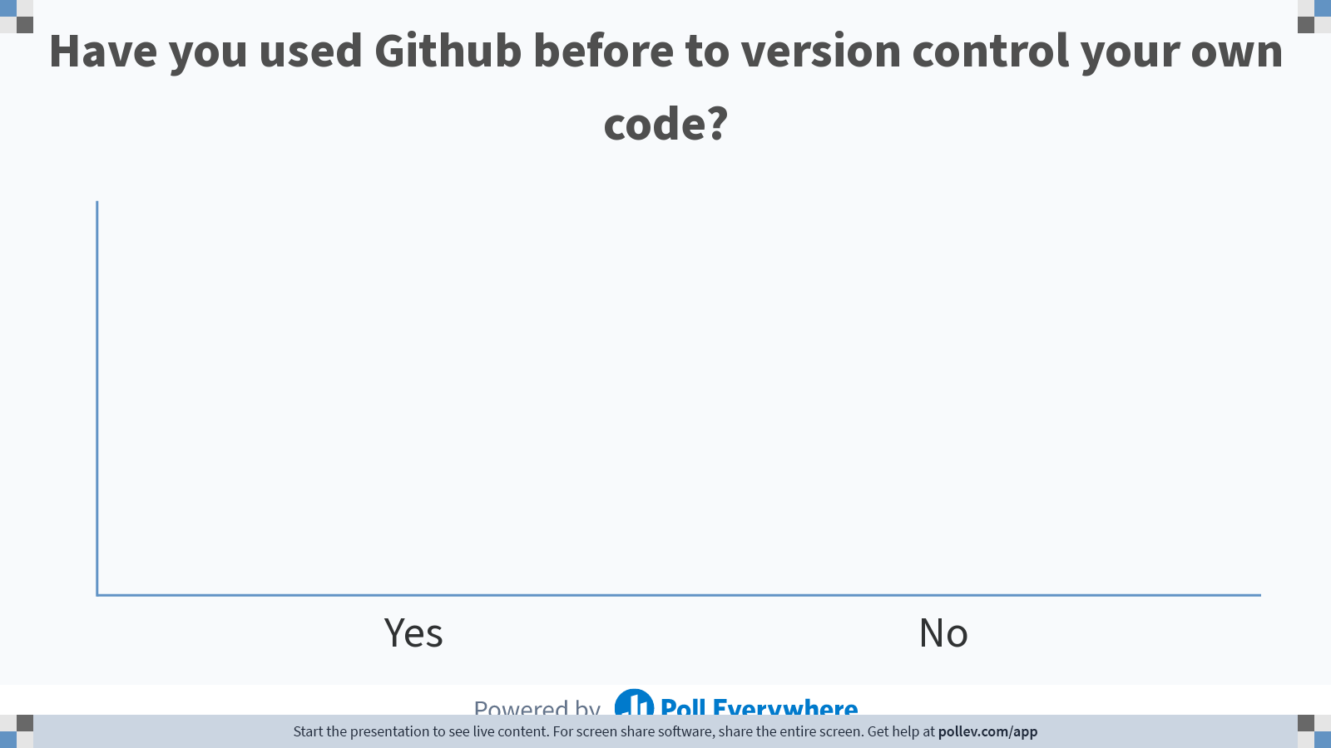
Notes:
Do not modify the notes in this section to avoid tampering with the Poll Everywhere activity. More info at polleverywhere.com/support Have you used Github before to version control your own code?
https://www.polleverywhere.com/multiple_choice_polls/F2AKaKNoTD1lqHgarQbOA

Slide 10
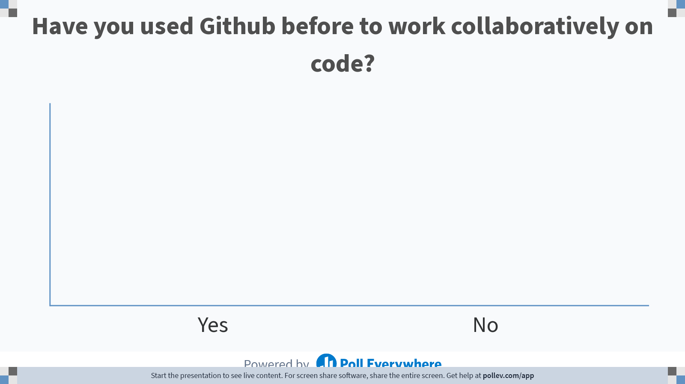
Notes:
Do not modify the notes in this section to avoid tampering with the Poll Everywhere activity. More info at polleverywhere.com/support Have you used Github before to work collaboratively on code?
https://www.polleverywhere.com/multiple_choice_polls/8Sqp1axd1cuQT688DTRNn

Slide 11
Where we organize what we want to commit to our repository
https://github.com/fedosejev/front-end-course/blob/master/week-01/day-01/learn-git.md

Slide 12
Git Commands
git config --global [user.name] [user.email]
init
status
add [-filename] [-A]
reset [-filename]
Commit -m
log
Notes:
Explains who is editing the repo
Initializes a new git repository

Slide 13
Cloning a remote repo
clone <url> <local place to clone>
remote –v
branch –a
diff
push [origin master]
pull
Try cloning the repository at https://github.com/jessilyn/BME590_practice
Add your name to the readme file

Slide 14
On your own: Github Demo

Slide 15
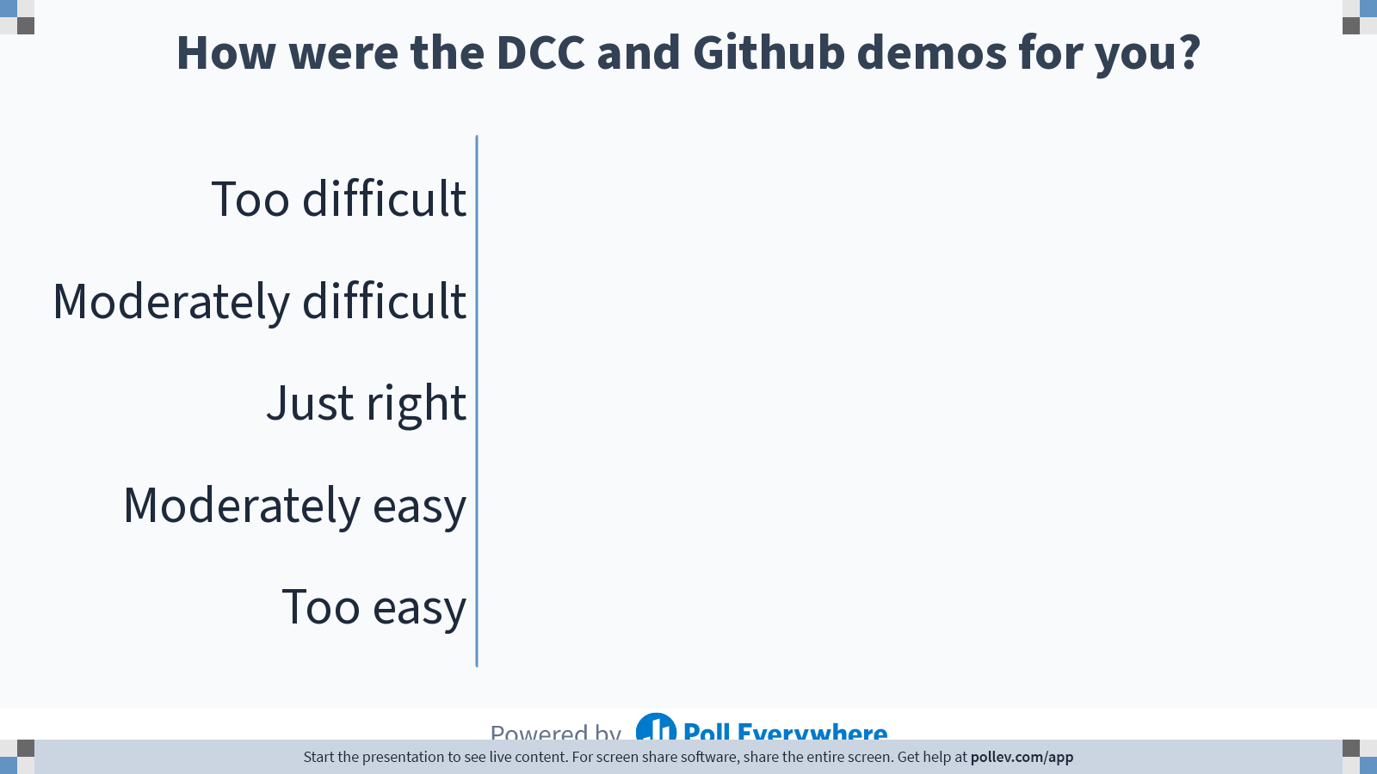
Notes:
Do not modify the notes in this section to avoid tampering with the Poll Everywhere activity. More info at polleverywhere.com/support How were the DCC and Github demos for you?
https://www.polleverywhere.com/multiple_choice_polls/n8lftKuT9D4ylCF4EjfWW

Slide 16
Data Lineage Electronic Health Records Data
Materials adapted from Ben Goldstein

Slide 17
Biomedical Data Collection Modalities
Omics
Imaging
Electronic Health Records (EHRs)
Wearable Sensors

Slide 18

Electronic Health Records
An electronic version of a patients medical history maintained by a provider over time
May include key administrative clinical data relevant to that persons’ care under a particular provider, including demographics, progress notes, problems, medications, vital signs, past medical history, immunizations, laboratory data and radiology reports
https://www.cms.gov/Medicare/E-Health/EHealthRecords/index.html
https://www.healthit.gov/faq/what-electronic-health-record-ehr

Slide 19
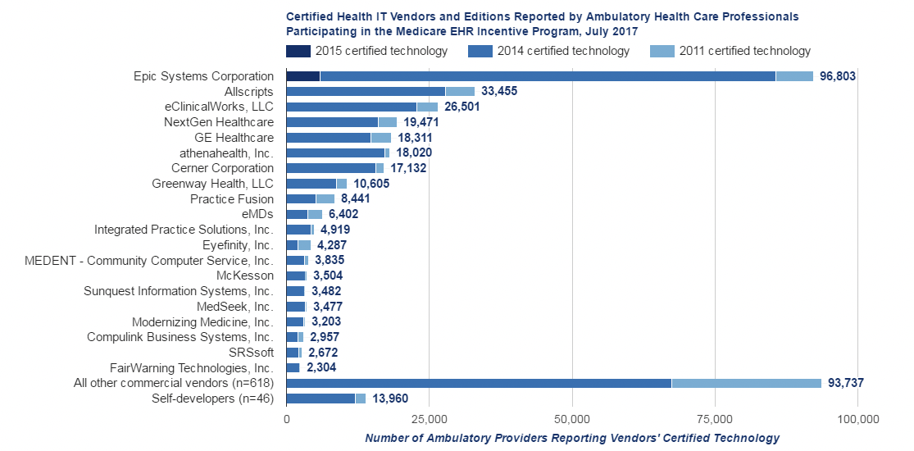
EHR Vendors
Duke’s EHR vendor
https://dashboard.healthit.gov/quickstats/pages/FIG- Vendors- of- EHRs- to- Participating- Professionals.php

Slide 20
What is the goal of the EHR?
Automates access to information
Meant to to streamline the clinician's workflow
May support other care-related activities directly or indirectly:
evidence-based decision support
quality management
outcomes reporting
According to CMS: The data, and the timeliness and availability of it, will enable providers to make better decisions and provide better care.

Slide 21
Why is the reduction of medical errors through EHRs debatable? Example:
Clinical note: Schizophrenia- continue Invega to target psychosis and continue Ativan to target anxiety- pt remains actively delusional with periods of AH and VH and paranoia. - continue with Invega 9 mg daily and Ativan 1 mg every 6 hours as needed. Pt is not displaying psychotic AH…
Expert clinician EHR analysis: guesses that provider copied note forward from a previous visit (“smart phrases”) and that patient was actively delusional in past but is now doing better. Copy forward enables assessments to become running list instead of accurate summary of a single visit.
Notes:
AH/VH- auditory or visual hallucinations

Slide 22
Why EHRs Are Useful For Clinical Research
Data readily available
Often +100,000’s of patients
Information collected across a variety of fields
Can study most clinical outcomes
Representative populations

Slide 23
Limitations of using EHRs For Clinical Research
Data are not organized for research
Data exist in disparate places
High levels of missingness and errors in the data
All patients have different pieces of information
Observational data*
* Except in more recent cases with active, EHR-based clinical trials. E.g. SepsisWatch

Slide 24
What we can do with EHRs
Risk Prediction
Near term prediction - Risk of in hospital sepsis
Long(er) term risk - 30 Day Readmission to the hospital
Population Health
Health Service Utilization - Assessment of high utilizers
Disease Epidemiology - Experience of incident diabetes in Durham County
Comparative Effectiveness Research (CER)
Retrospective Studies - Assessment of community intervention for diabetics (SEDI)
Prospective Studies - Point of care randomization
Association Analyses
Risk factors for disease - Phenome Wide Association Studies
Data mining - Drug-Drug interactions
Notes:
On Quiz will have to give examples of all four of these types of EHR modelling

Slide 25
EHR Based Studies
 | Retrospective | Prospective
Risk Prediction | Returning to Hospital 30 days after discharge | Implement alert for Readmissions Risk
Intervention Assessment | Compare Medical vs Surgical Treatment | Point of Care Randomization
Population Health | Experience of Incident Diabetes | Screening for Diabetes
Notes:
Retrospective: using past data
Prospective: at this point in time and looking forward

Slide 26
Example Clinician EHR Interface

Slide 27
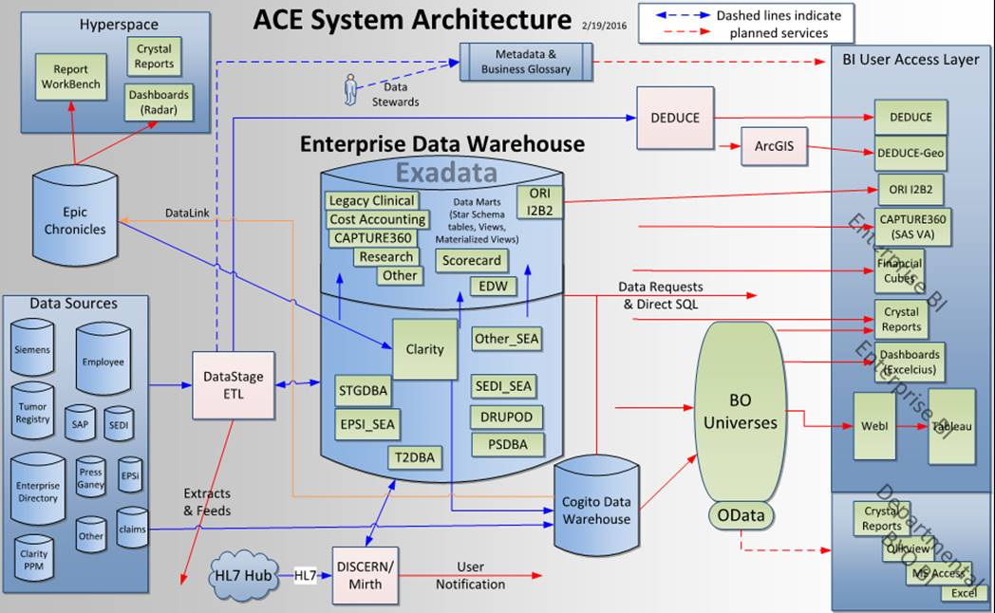
Back End of EHRs

Slide 28
Epic Data Model
data sources for a wide variety of user types
Data stored immediately
Data stored overnight
~200 TABLES
CABOODLE
Disease-specific Registries
-Diabetes
-Afib
-Etc
Analytic Tools
-Provider Dashboards
-Predictive Models
(e.g. SepsisWatch)
-Etc
http://healthitmhealth.com/using-epic-cogito-data-warehouse-population-health-management/

Slide 29
Data Elements
Patient Demographics
Encounters (Outpatient/Inpatient)
Diagnoses
Procedures
Lab Results
Vital Signs
Medications
Social History
Radiological Results
Doctor Notes

Slide 30
Data Elements
Patient Demographics
Encounters (Outpatient/Inpatient)
Diagnoses
Procedures
Lab Results
Vital Signs
Medications
Social History
Radiological Results
Doctor Notes

Slide 31
Demographics
Patients have a single ID that follows them across all encounters - medical record number (MRN)
MRN is specific to the medical system (not like a social security number)
Basic information: Birth date, Sex, Race/Ethnicity that is typically static
Time varying elements include: Payer, address

Slide 32
Data Elements
Patient Demographics
Encounters (Outpatient/Inpatient)
Diagnoses
Procedures
Lab Results
Vital Signs
Medications
Social History
Radiological Results
Doctor Notes

Slide 33
Encounter Type
Encounters have an encounter ID that links the encounter context to what happened (diagnoses, tests etc.)
Three Basic Encounters:
Outpatient (AV - Ambulatory Visit)
Inpatient (IP)
Emergency Department (ED)
Other types of encounters can include telephone consults, emails etc.*
* TeleHealth is becoming more prevalent (e.g. video calls with clinicians)

Slide 34
Contextualizing Information For Encounters
When someone seen (i.e. time stamps for arrival and departure)
Who the patient saw (i.e. provider specialty, provider type)
Where the patient was seen (i.e. clinic location, facility type)
What happened (i.e. vital signs, labs taken, diagnoses made)
We don’t have good information on Why — diagnoses don’t often relate to “chief complaint”

Slide 35
Data Elements
Patient Demographics
Encounters (Outpatient/Inpatient)
Diagnoses
Procedures
Lab Results
Vital Signs
Medications
Social History
Radiological Results
Doctor Notes

Slide 36
International Classification of Diseases (ICD) Codes
System to code all diagnoses that are made during a health encounter
In 2015 the US switched to the ICD-10 system (previous ICD-9)
ICD-9 had ∼13,000 unique codes, ICD-10 has ∼68,000
Since these are used as billing codes, the codes can be manipulated to increase billing
Codes don’t always represent the primary concern

Slide 37
ICD Codes Get Specific!
V97.33XD: Sucked into jet engine,
subsequent encounter.
W61.62XD: Struck by duck,
subsequent encounter.
https://gizmodo.com/struck-by-a-duck-the-strangest-new-codes-in-the-new-me-1734073564
https://www.healthcaredive.com/news/the-16-most-absurd-icd-10-codes/285737/
https://www.icd10illustrated.com/index.html

Slide 38
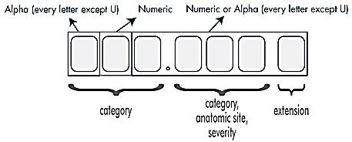
Structure Of ICD-10 Codes
Myocardial Infarction: I21 ⇒ Acute Myocardial Infarction
Subsequent numbers designate location of event, e.g. I21.01 ⇒ MI of left main coronary artery
I22 ⇒ Subsequent MI I23 ⇒ Complications of MI
https://www.who.int/classifications/icd/ICD-10_2nd_ed_volume2.pdf
https: //www.icd10data.com/ICD10CM/Codes/I00-I99/I20-I25

Slide 39
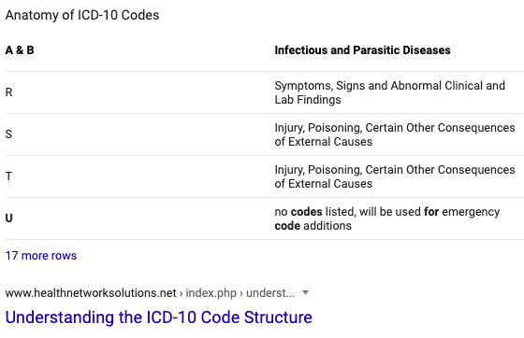
Why is the letter U not used in the original ICD 10 code set?
This letter was made available for future code set expansion- will be used for emergency code additions.
U06- Zika virus disease
U07.0 - Vaping-related disorder
U07. 1- COVID-19, virus identified - assigned to a disease diagnosis of COVID-19 confirmed by laboratory testing.
https://www.cdc.gov/nchs/data/icd/COVID-19-guidelines-final.pdf
https://www.icd10monitor.com/memorizing-icd-10-cm-by-the-letters-part-3

Slide 40
Data Elements
Patient Demographics
Encounters (Outpatient/Inpatient)
Diagnoses
Procedures
Lab Results
Vital Signs
Medications
Social History
Radiological Results
Doctor Notes

Slide 41
Current Procedural Terminology (CPT) Codes
CPT is coding system for what happened during an encounter
∼ 10,000 CPT codes in use
Also tied to reimbursements
Similar organizational systems as with ICD codes

Slide 42
Data Elements
Patient Demographics
Encounters (Outpatient/Inpatient)
Diagnoses
Procedures
Lab Results
Vital Signs
Medications
Social History
Radiological Results
Doctor Notes

Slide 43
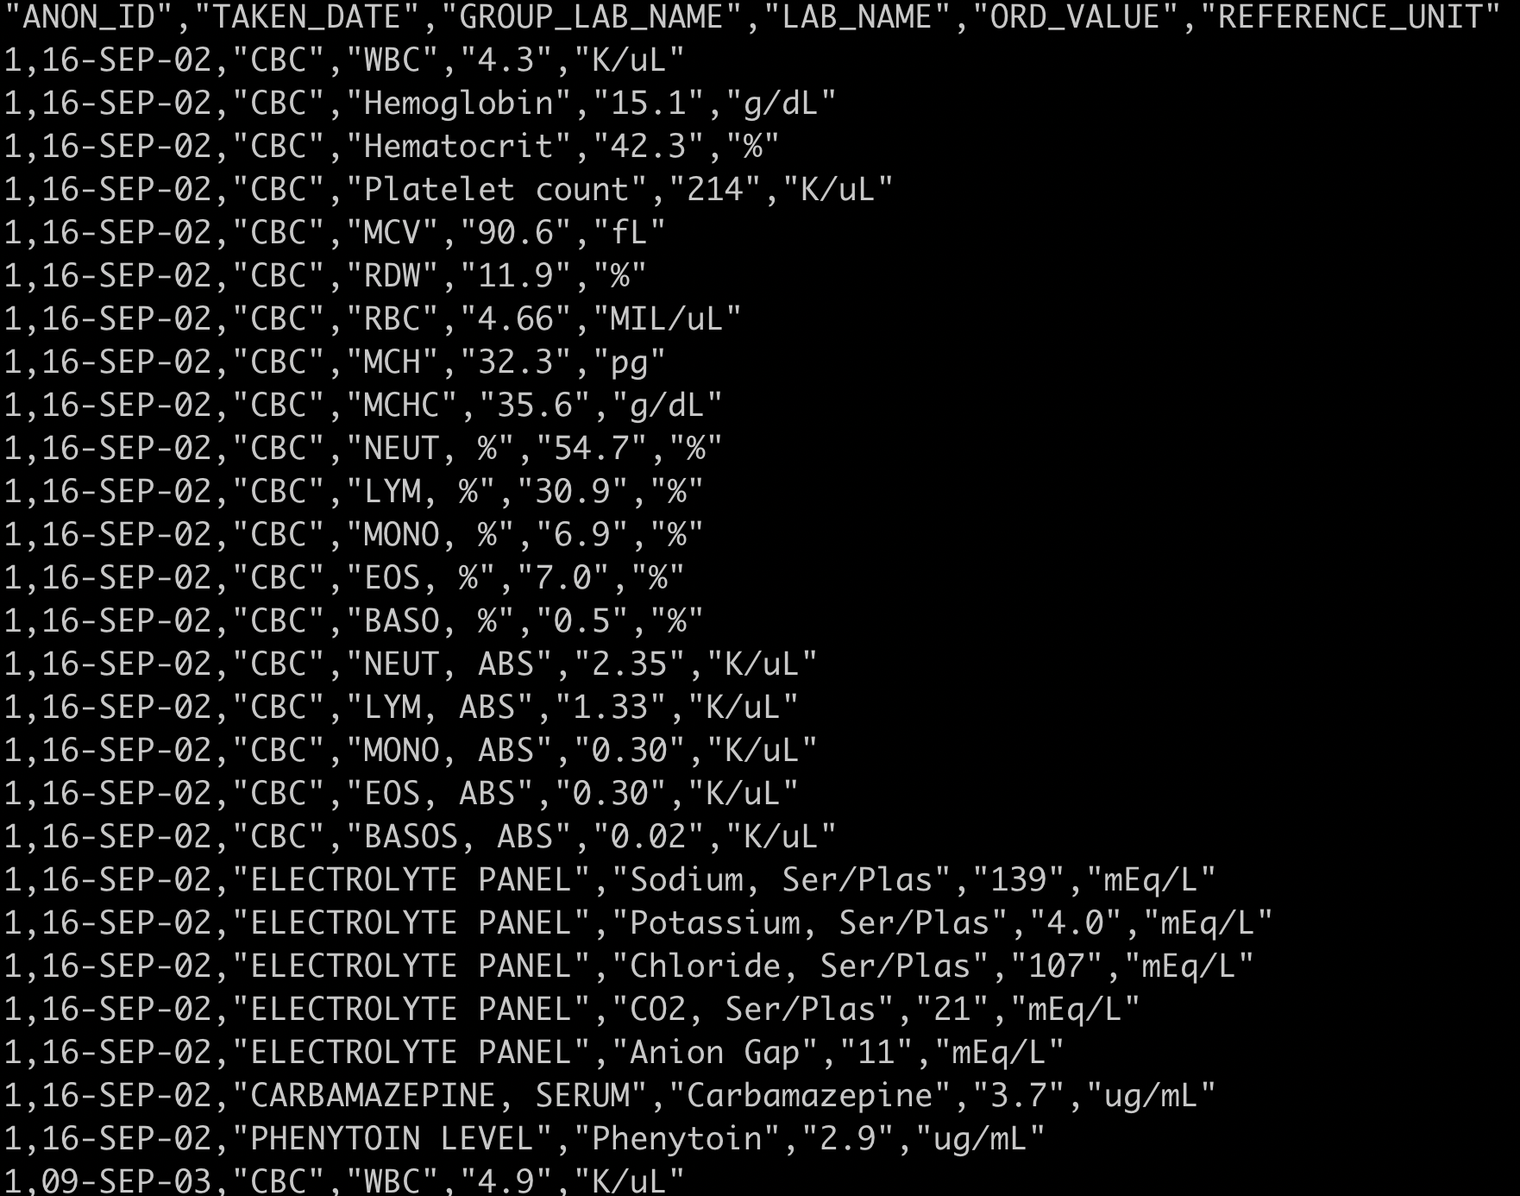
Lab Results & Vital Signs
Numeric values and metadata
more typical tabular data

Slide 44
Vitals and Laboratory Data
These measurements differentiate EHRs from administrative data
Modern systems have standardized the nomenclature of laboratory tests
An analytic concern is that these measurements are irregularly captured across encounters
For inpatient encounters these will often be captured multiple times over the encounter organized as a running tally called flowsheets

Slide 45
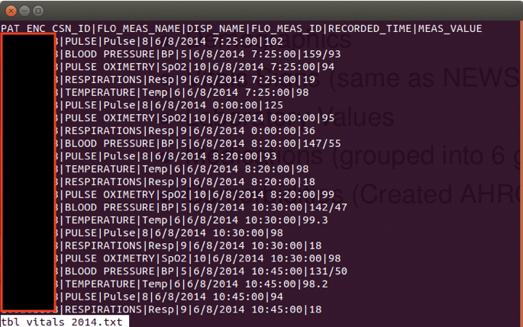
Vitals Flowsheets

Slide 46
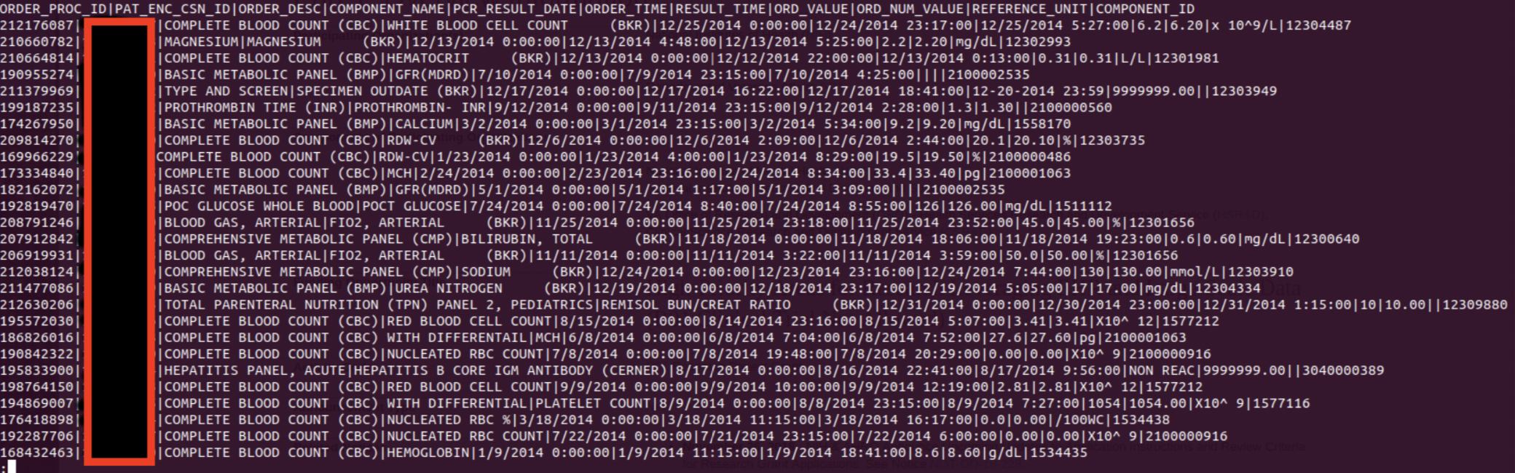
Labs Flowsheets

Slide 47
Data Elements
Patient Demographics
Encounters (Outpatient/Inpatient)
Diagnoses
Procedures
Lab Results
Vital Signs
Medications
Social History
Radiological Results
Doctor Notes

Slide 48
Medications
Medications are often captured in the EHR as “prescribed”
Does not necessarily mean a patient filled the prescription, or that they took the medication
Like diagnoses and procedures, captured medications can become diffuse and sparse
RxNorm is a normalized naming system and can be used to organize medications into hierarchies
https://www.nlm.nih.gov/research/umls/rxnorm/overview.html
https://mor.nlm.nih.gov/RxNav/search?searchBy=String& searchTerm=acetaminophen

Slide 49
Data Elements
Patient Demographics
Encounters (Outpatient/Inpatient)
Diagnoses
Procedures
Lab Results
Vital Signs
Medications
Social History
Radiological Results
Doctor Notes

Slide 50
Social Health
Data such as smoking status, drug and alcohol use, employment status, marital status etc. may be reported but typically isn’t reliable
Socio-economic status typically doesn’t exist but proxies can be used via primary payer or neighborhood address
There is a growing emphasis on capturing patient reported outcomes (PROs/e-PROs)

Slide 51
Data Elements
Patient Demographics
Encounters (Outpatient/Inpatient)
Diagnoses
Procedures
Lab Results
Vital Signs
Medications
Social History
Radiological Results
Doctor Notes

Slide 52
Unstructured Data
Structured Data refers to quantitative data in a “ready to analyze” format
Growing emphasis on incorporating unstructured data which requires some pre-processing
Examples of unstructured EHR data include:
Notes
Images
Genetic data

Slide 53
Missing Data In EHR Data Sets
Data in EHRs are typically not missing but are not collected
Data are Not Missing At Random (NMAR) - typical imputation strategies would not be appropriate
Often want to include proxy measures:
Missing categories
Number of previous encounters
Number of times a lab was tested or code was documented
Most typically provide missing categories for variables

Slide 54
Handling Informative Missing Data Laboratory Data
Example: Modeling a lab value like blood glucose:
If we have a high degree of missingness (> 10%) and that missingness is informative (e.g. only diabetic patients have blood glucose measured), then we don’t want to simply impute the value
Instead we may choose to make a missingness category and then categorize the observed values
E.g. create a 4 level variable: Not taken, Normal Range, Above Normal, Below Normal

Slide 55
Need For Computable Phenotypes
EHR data do not have direct information on phenotypes
Phenotypes are difficult to define
“Problem Lists” exist but are not always reliable/consistent
We can develop data-driven algorithms to define disease states
The algorithms typically have high positive predictive value and specificity¹
[1] Quan H, Li B, Saunders LD, Parsons GA, Nilsson CI, Alibhai A, Ghali WA; IMECCHI Investigators. Assessing validity of ICD-9-CM and ICD-10 administrative data in recording clinical conditions in a unique dually coded database. Health Serv Res. 2008 43(4):1424-41.

Slide 56
What is a Diabetic?
Challenges in Defining Phenotypes
Richesson RL, Rusincovitch SA, Wixted D, Batch BC, Feinglos MN, Miranda ML, Hammond WE, Califf RM, Spratt SE. A Comparison of Phenotyp Definitions for Diabetes Mellitus. J Am Med Inf Assoc 2013 (epub ahead of print). http://www.ncbi.nlm.nih.gov/pubmed/24026307

Slide 57
Multiple Measurements Per Person
Opportunities
Get to observe patient’s evolving health status
More frequent visits than a typical longitudinal study
Denser visit information
Challenges
Visits are irregularly spaced
Different ways to aggregate
You can’t know what you don’t see in the data

Slide 58
Summary
Turning EHR data into analytic data is an involved process that requires many choices
As a biostatistician or biomedical data scientist, we may sit downstream of these choices and not get to test their impact
The temporal structure of EHR data opens up the need for different analytic methods

Slide 59
Examples of Large Clinical or “Linked” Datasets
Electronic health records and Claims data
Almost always need to pay or apply to have access
CMS “Snapshots”
Kaiser Permanente (30 million people)
Optum (216 million people)
Large Clinical Studies
DCRI
UK Biobank (publicly-accessible)
All of Us (publicly-accessible)
MIMIC / PhysioNet critical care database (publicly-accessible)
Health and Retirement Study (HRS)
NHANES

Slide 60
Have a great afternoon!
Still looking for project group members?
Hang back for a few minutes after class, or send me an email

